Slide 1
Pharmaceutical sales prediction
INTERIM SUBMISSION

Slide 2
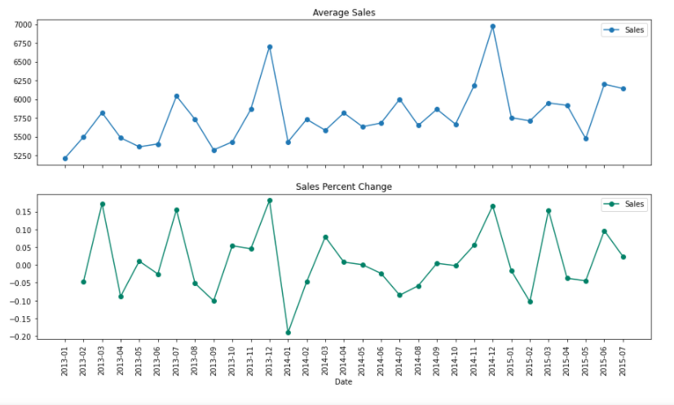
SEASONALITY
The trend in seasonality is high purchases recorded around festive seasons and holidays compared to the remaining part of the year.

Slide 3
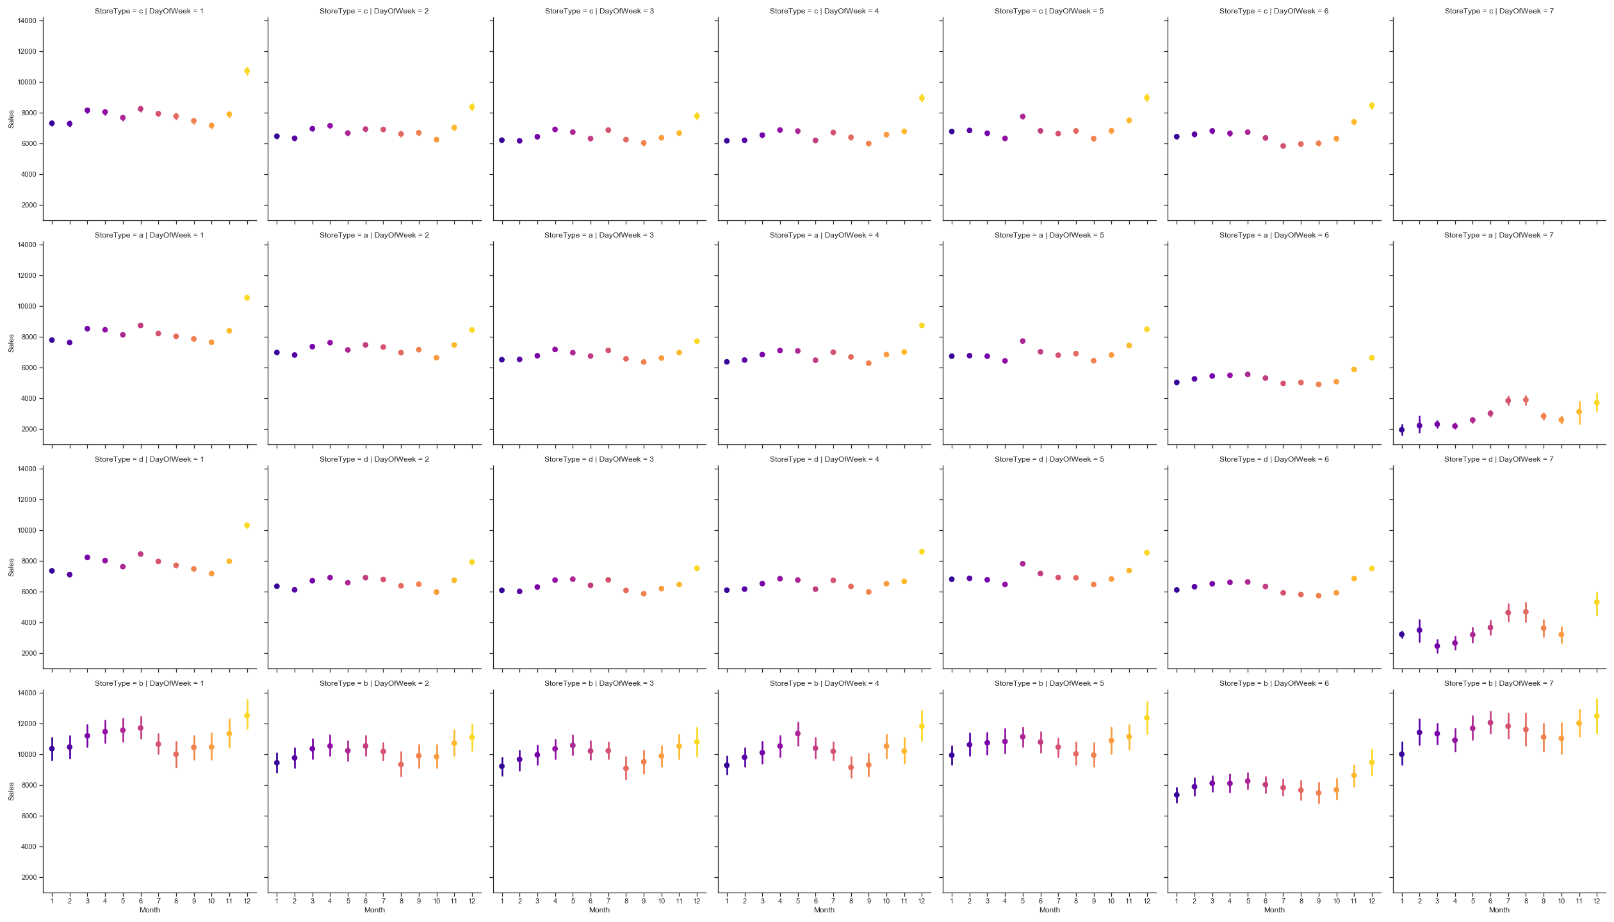
PURCHASE BEHAVIOR
Sales are relatively low before holidays, but then rise steadily towards holidays.
They remain high during holidays.
Sales drop rapidly after holidays.
Generally, purchases rise during holidays and remain relatively low when there are no holidays.

Slide 4
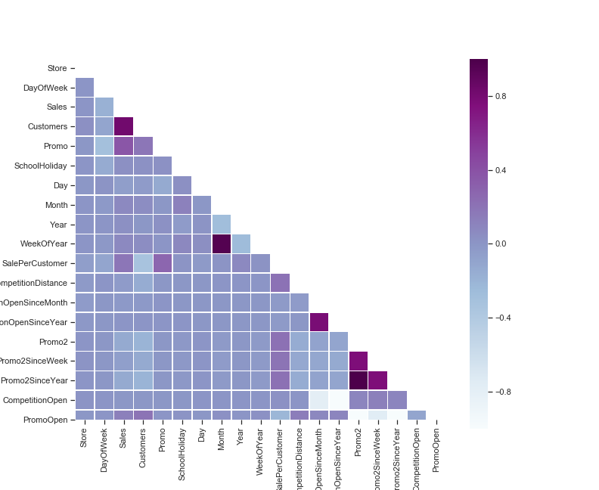
CORRELATION BETWEEN SALES AND CUSTOMERS
We can see a strong positive correlation between the amount of Sales and Customers of a store.

Slide 5
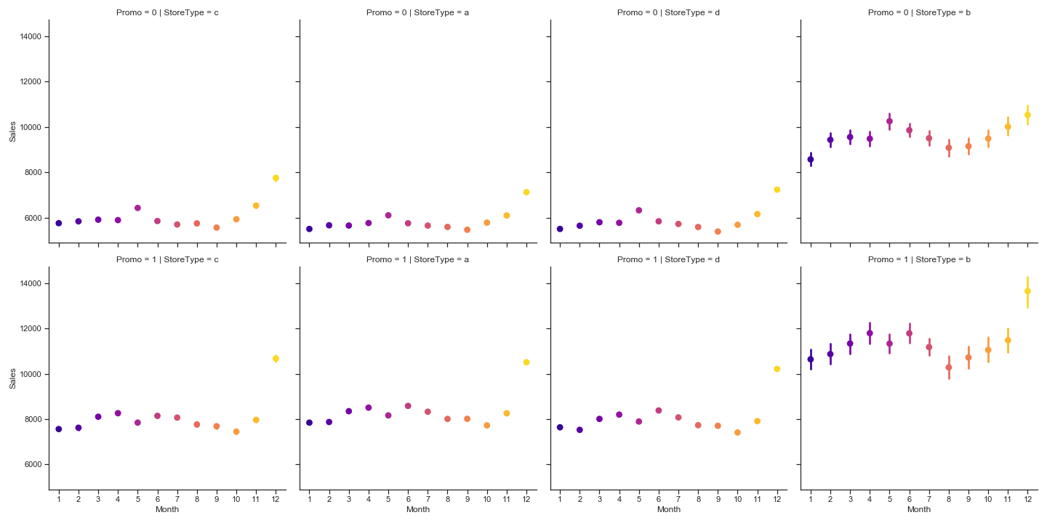
RELATIONSHIP BETWEEN PROMO AND SALES
There seems to be higher sales when there is promotion (promo = 1) than when there is no promotion (promo = 0)

